Slide 1







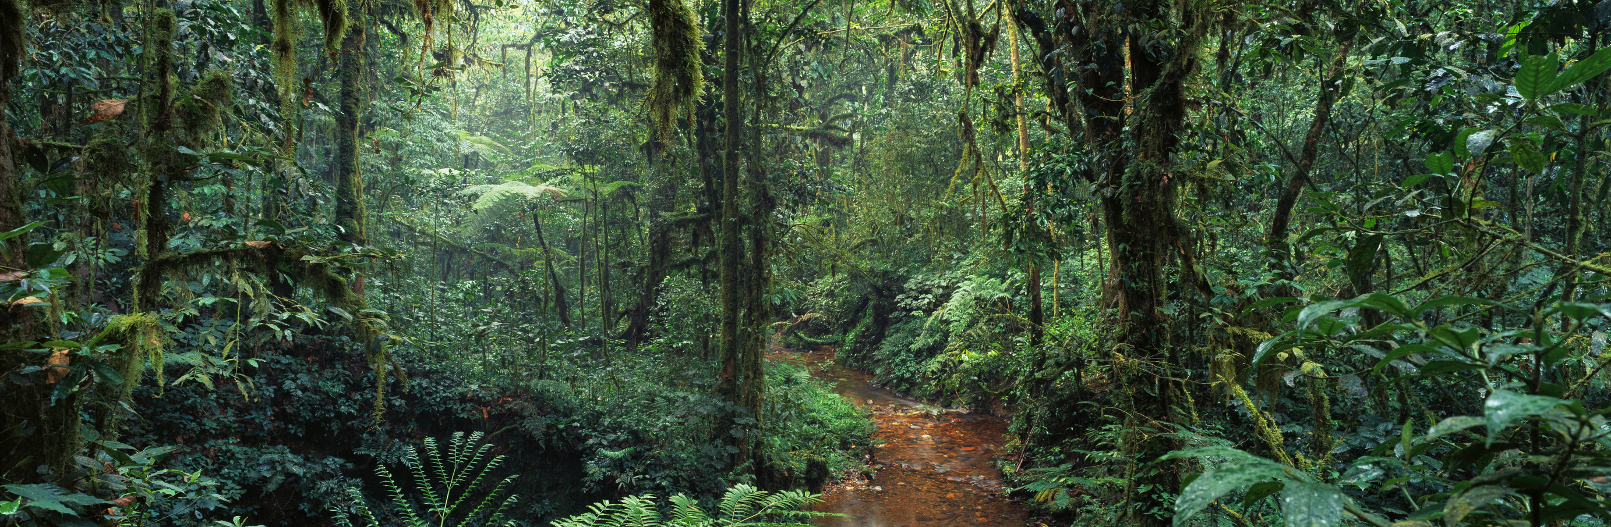
Outdoor Activities and Adventure Trends
Presented By :
TEAM 113

Slide 2





BUSINESS CONTEXT
Outdoor recreation is a rapidly growing industry, encompassing activities such as hiking, camping, and water sports.
Businesses and tourism boards are increasingly relying on data-driven insights to improve customer satisfaction.
Customer reviews on platforms like Yelp contain valuable feedback but are often unstructured and difficult to analyze.
This project applies machine learning (ML) and natural language processing (NLP) to extract insights from Yelp reviews and business data to identify market trends and customer preferences.

Slide 3


INDUSTRY STATISTICS AND MARKET TRENDS
ECONOMIC IMPACT
SOCIAL MEDIA INFLUENCE:
The outdoor recreation industry contributes $862 billion to the U.S. economy.
Outdoor experiences have high social media engagement—with over 10 million outdoor-related hashtags on Instagram & Twitter.
Influencers and outdoor enthusiasts drive trends and attract new participants through travel vlogs, adventure blogs, and social media challenges.
PARTICIPATION GROWTH
168 million Americans engaged in outdoor activities in 2023—a 6.9% increase from previous years.
Hiking and camping participation grew by 15% in the last five years, showing consistent growth in demand.

Slide 4

PURPOSE OF INVESTIGATION
Understand Customer Preferences: Analyze Yelp reviews to reveal what outdoor enthusiasts value most.
Leverage Machine Learning & NLP: Use advanced analytics to extract insights from unstructured text data.
Predict Future Trends: Identify shifts in consumer behavior to help businesses adapt and innovate.
Support Data-Driven Decision Making: Provide actionable recommendations for businesses, tourism boards, and investors.
Enhance Customer Satisfaction: Enable businesses to tailor experiences and improve service offerings based on data insights.

Slide 5

DATASET SUMMARY
Data Source:
Yelp Open Dataset – Contains reviews & business data for hiking, camping, and water sports businesses.
Data Collected:
Business Data: Name, category, location, service attributes.
Review Data: Star ratings (1-5), text reviews, timestamps.
Data Exclusion:
COVID-period reviews (2020-2021) were excluded to remove bias caused by lockdowns and restrictions.

Slide 6
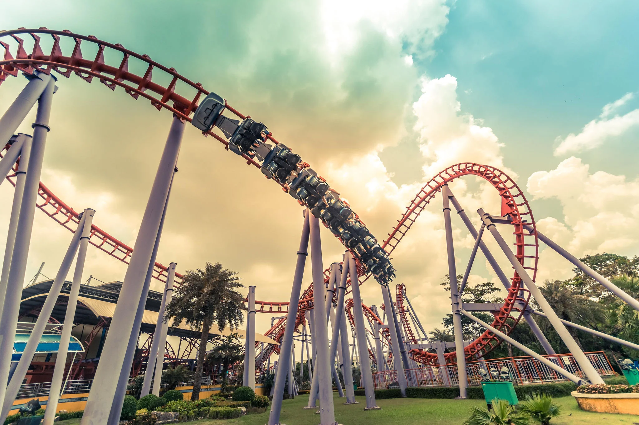
DATA ISSUES AND SOLUTIONS
Missing & Noisy Data:
Some reviews were too short or contained irrelevant content. Solution: Removed incomplete reviews and applied text preprocessing.
Bias in Reviews:
Customers tend to leave reviews only for extreme experiences (either 1-star or 5-star ratings). Solution: Used VADER Sentiment Analysis to classify sentiment without being influenced by rating bias.
Inconsistent Text Data:
Reviews contained typos, slang, or special characters, affecting analysis. Solution: Cleaned text using NLP preprocessing (stopword removal, lemmatization, punctuation removal).

Slide 7

ANALYTICAL METHODS
Exploratory Data Analysis (EDA)
Objective: Understand dataset structure, detect patterns, and identify missing values.
Methods: Data inspection, missing value checks, category filtering, and visualizations.
Sentiment Analysis Using VADER
Objective: Determine sentiment polarity in customer reviews. A model that assigns sentiment scores.
Methods: VADER’s SentimentIntensityAnalyzer to classify reviews as positive, neutral, or negative based on compound sentiment scores.

Slide 8
ANALYTICAL METHODS
Data Preprocessing for NLP
Objective: Clean and prepare text data for analysis.
Methods: Lowercasing, tokenization, stopword removal, lemmatization, and filtering for meaningful words using nltk.
Handling Missing Values – Removed reviews with empty text fields..
Text Cleaning:
1. Removed stopwords, special characters, and redundant words.
2. Applied lemmatization for improved classification.
3. Tokenized text for better NLP-based analysis.
Feature Engineering & Transformation
Objective: Convert raw data into structured features for analysis.
Methods: Creating sentiment-based features, word frequency analysis, and category mapping for business types.

Slide 9
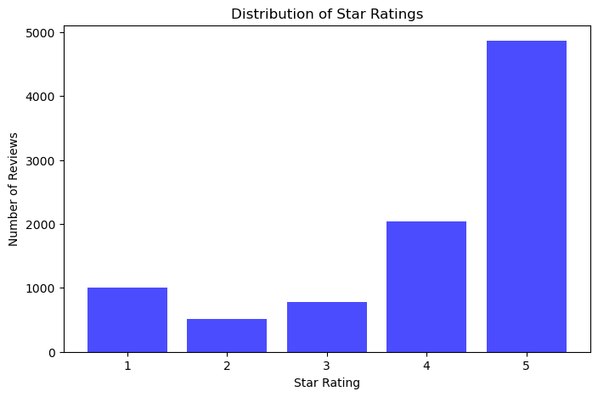
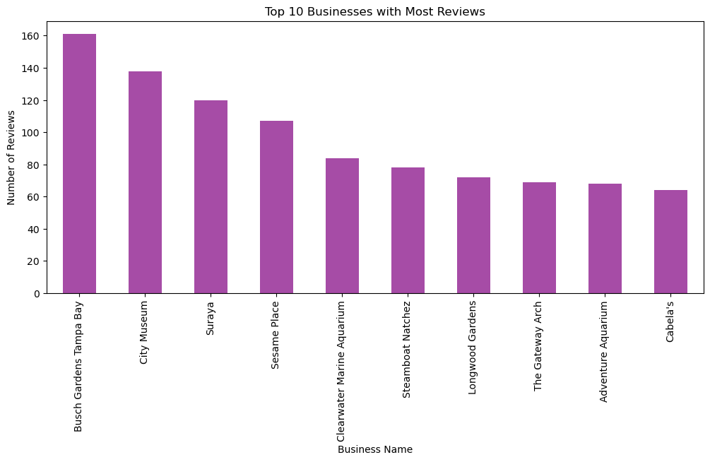
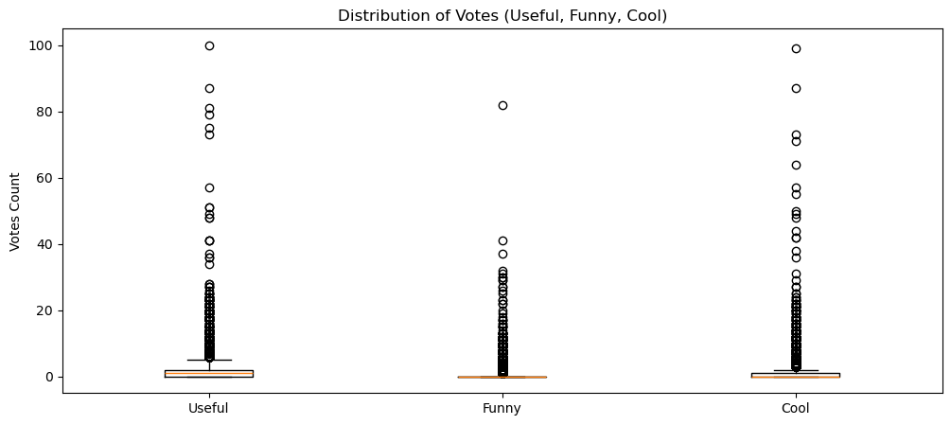
FINDINGS & VISUALIZATIONS

Slide 10
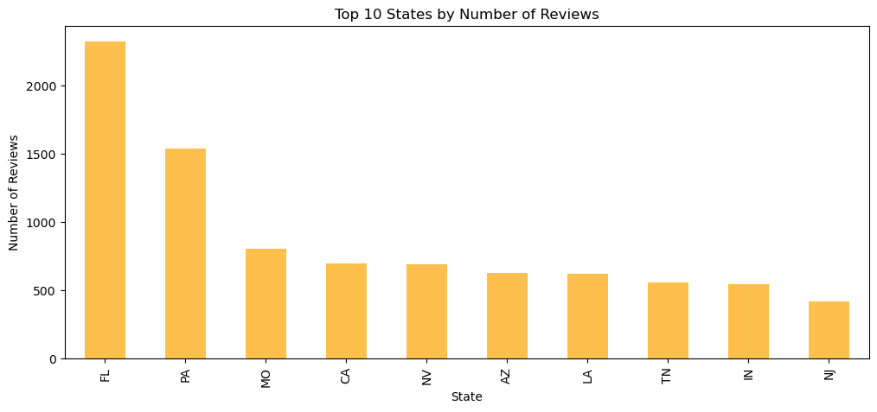
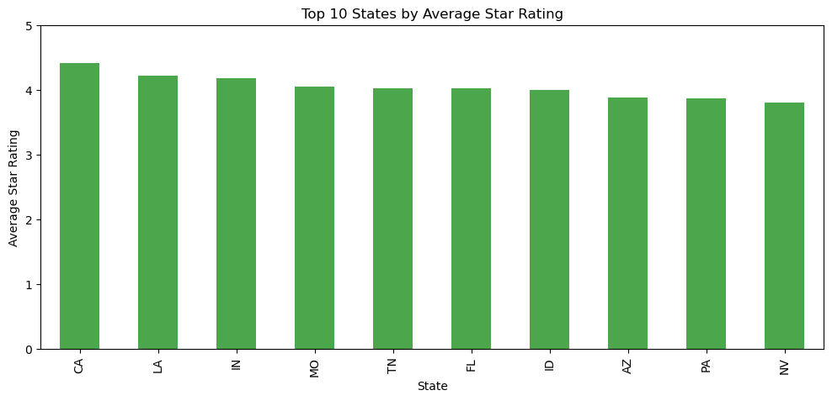
FINDINGS & VISUALIZATIONS

Slide 11
FINDINGS & VISUALIZATIONS
Top States by Average Star Rating
California (CA) and Louisiana (LA) lead in average ratings, indicating higher customer satisfaction in outdoor activities.
Most states in the top 10 have an average rating above 4.0, showing a generally positive sentiment.
Nevada (NV) and Pennsylvania (PA) have slightly lower ratings, suggesting room for improvement in outdoor business offerings.
Top States by Number of Reviews
Florida (FL) dominates in review count, indicating high customer engagement in outdoor activities.
Pennsylvania (PA) and Missouri (MO) also have strong review volumes, suggesting popular tourist destinations in these states.
California (CA) appears in both top-rated and most-reviewed states, reinforcing its position as a key location for outdoor experiences.
Key Insights for Businesses & Tourism
High review counts do not always correlate with the highest ratings, meaning businesses must focus on service quality as well as engagement.
States with lower ratings but high review counts (e.g., PA, NV) present opportunities for businesses to enhance their offerings.
Tourism boards can leverage these insights to promote high-rated states and improve services in lower-rated locations.
Presentation By Juliana Silva

Slide 12
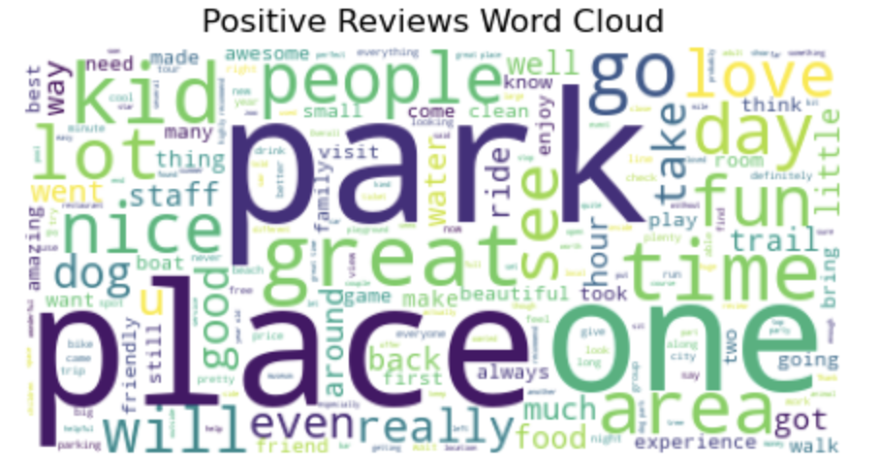
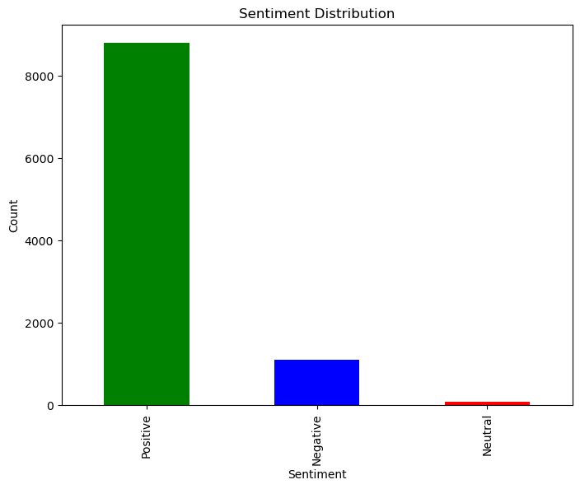
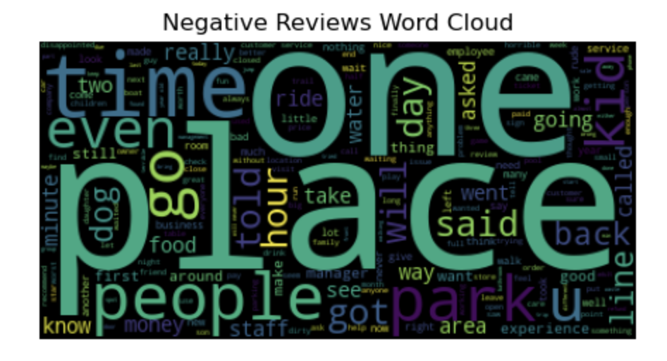
FINDINGS & VISUALIZATIONS

Slide 13
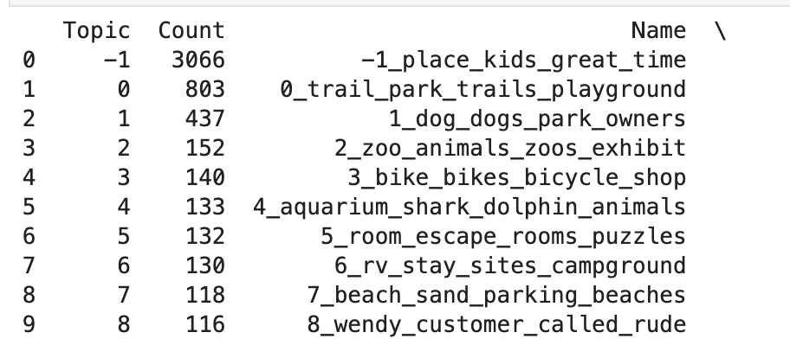
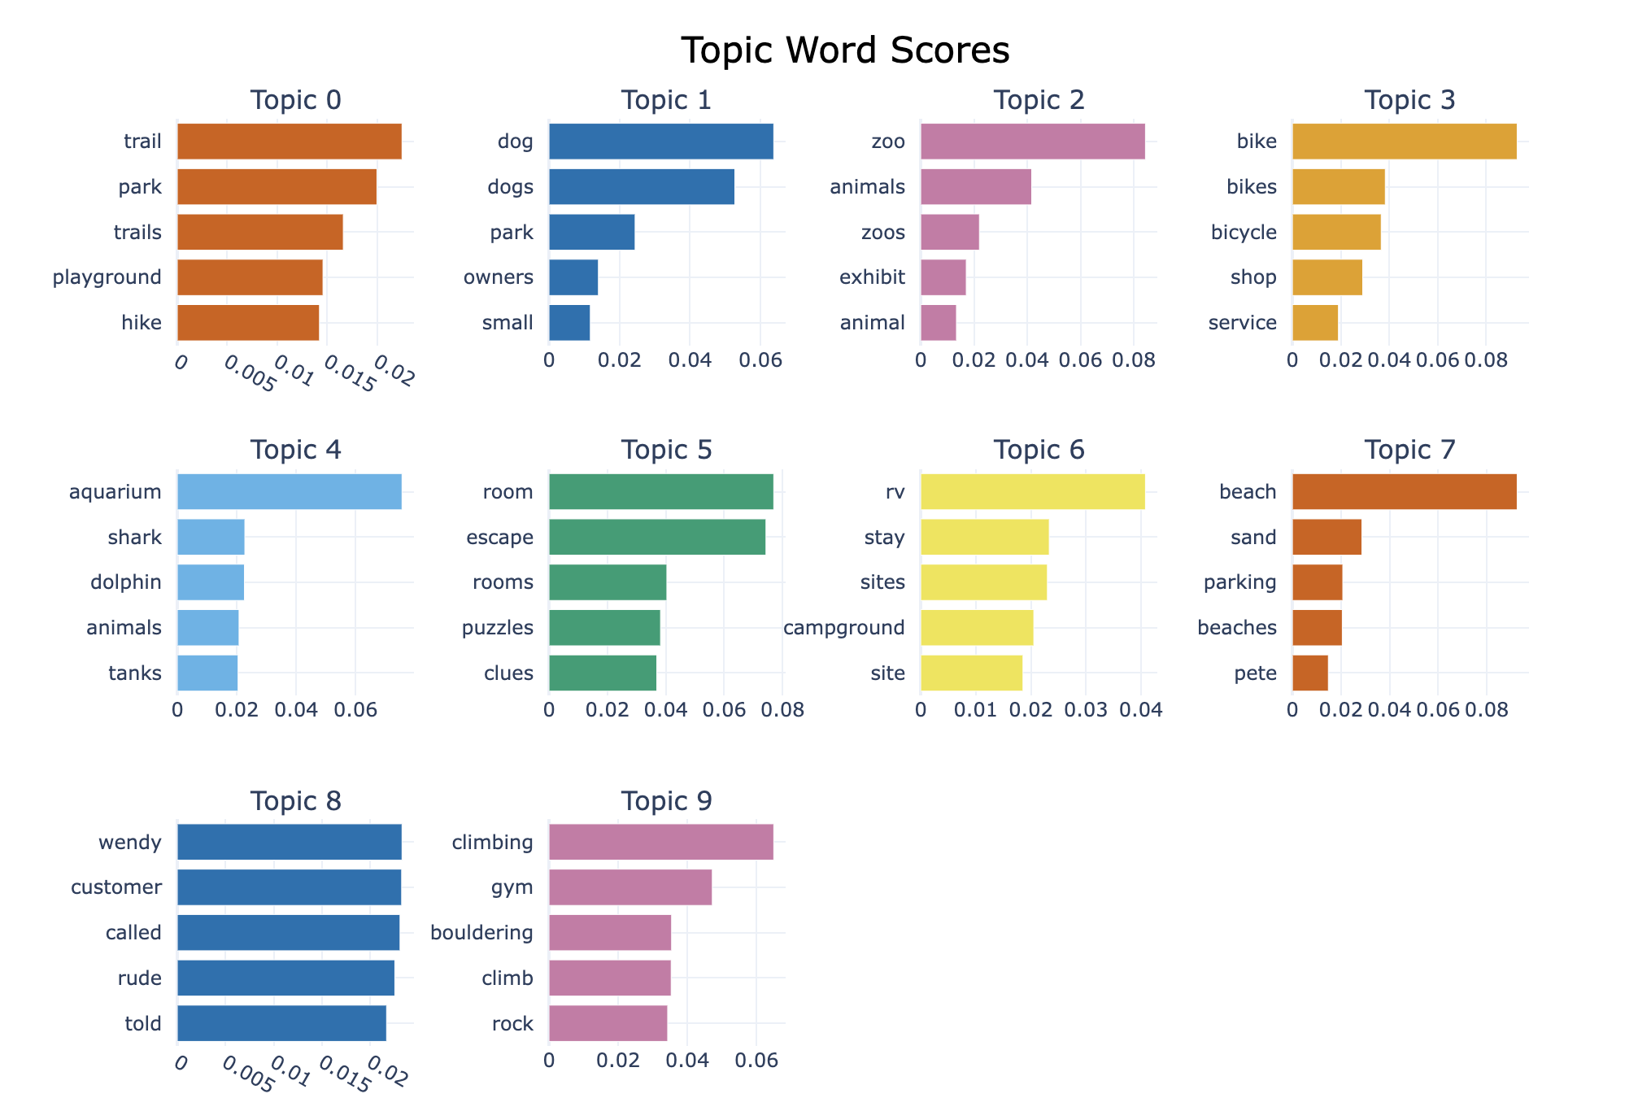
FINDINGS & VISUALIZATIONS
Main Themes: Reviews focus on outdoor recreation, including parks, dog parks, biking, zoos, beaches, and campgrounds.
Top Topics:Parks & Trails (803 reviews) – discussions on hiking trails and playgrounds.
Dog Parks (437 reviews) – experiences with dog-friendly areas.
Zoos & Aquariums (292 reviews combined) – mentions of animal exhibits.
Beaches & Campgrounds (248 reviews combined) – focus on outdoor stays.
Customer Service Issues (116 reviews) – complaints about interactions.
Topic Overlap: Some topics are closely related (e.g., parks and trails), while others are distinct.Business Insights: Improving amenities, pet-friendly spaces, and customer service can enhance visitor experiences.

Slide 14

MANAGERIAL INSIGHTS AND BUSINESS IMPLICATIONS
SERVICE QUALITY DRIVES REVIEWS
CUSTOMER SENTIMENT MATTERS
Negative feedback often focuses on pricing, long wait times, and customer service.
Addressing these areas can improve ratings and attract more customers.
88% of reviews are positive, indicating strong customer satisfaction, but businesses should address negative reviews to improve.
POPULAR BUSINESS CATEGORIES
Theme parks, museums, and aquariums receive the most reviews, meaning businesses in these sectors can leverage high engagement for marketing.

Slide 15
MANAGERIAL INSIGHTS AND BUSINESS IMPLICATIONS
EXPANSION INTO TRENDING OUTDOOR ACTIVITIES
HIGH-RATED STATES INDICATE FAVORABLE MARKET CONDITIONS
Investing in eco-tourism, adventure parks, and unique outdoor experiences can attract new markets.
Outdoor businesses in these states (CA, LA, IN, MO) can capitalize on positive reputation to attract more customers.
FLORIDA AND PENNSYLVANIA HAVE HIGH REVIEW VOLUMES BUT LOWER RATINGS
MARKETING STRATEGY BASED ON SENTIMENT ANALYSIS
Improving customer experience in these states can boost satisfaction and increase repeat visits.
Highlight common themes in 5-star reviews for branding (e.g., family-friendly, great service, scenic locations).
Address 1-star complaints in ads & promotions to show customer-focused improvements.

Slide 16
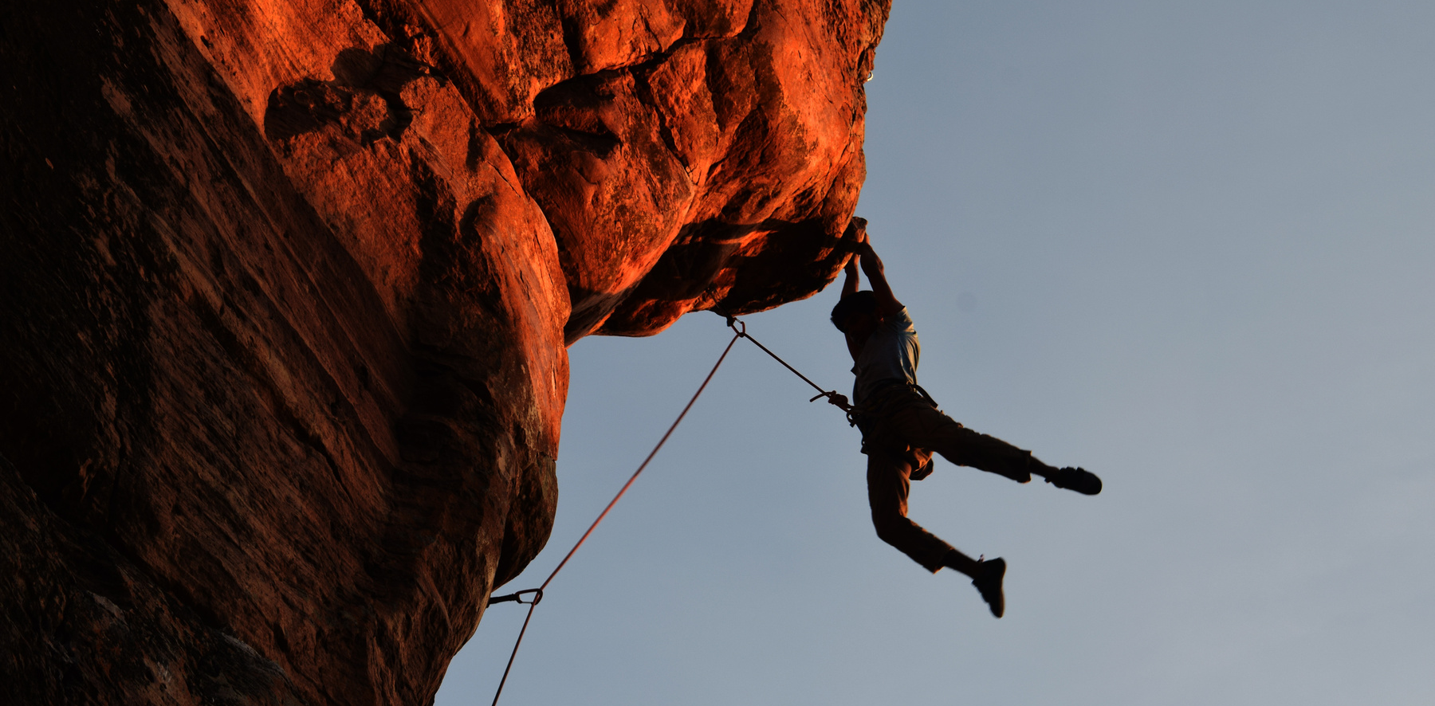
CONCLUSIONS AND RECOMMENDATIONS
Customer sentiment analysis provides valuable insights into what drives satisfaction and dissatisfaction.
Businesses should focus on service quality, pricing strategies, and customer experience improvements to enhance ratings.
High-rated states present strong business expansion opportunities, while low-rated states need service enhancements.
Tourism boards and businesses should use these insights to guide marketing efforts and future investments.
Future Work:
1. Extend analysis to predict seasonal demand for different activities.
2. Use AI-based recommendations to improve personalized customer engagement.

Slide 17
THANK YOU

